Slide 1
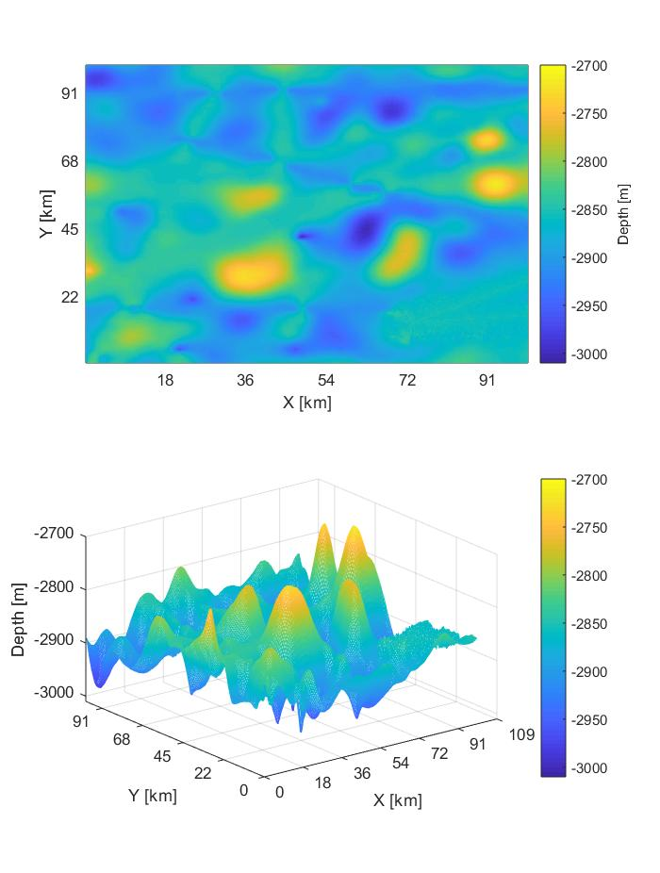
Bathymetry interpolation algorithms using AUV mission data
Alessia Annecchini
Alessia Guida
Lorenzo Irace
Giuseppe Longo

Slide 2
Previously on this topic
Most performant algorithms
Ideal case: spline interpolation
Noise: kriging and spline interpolation
Outliers: kriging and linear interpolation
But kriging is slow...
Noise and outliers: linear interpolation
Performances indexes: MSE and execution time (computing 95% confidence interval on 5 repetitions)
Physical bounds
Sample density incidence

Slide 3
Lineup
Path
Real bathymetry data
Trade-off plots

Slide 4
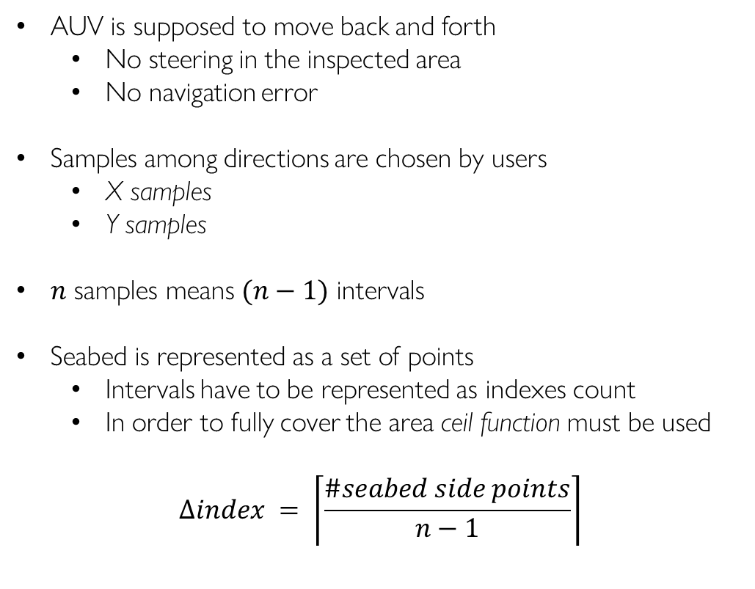
Path
AUV is supposed to move back and forth
No steering in the inspected area
No navigation error
Samples among directions are chosen by users
X samples
Y samples
$n$ samples means $(n−1)$ intervals
Seabed is represented as a set of points
Intervals have to be represented as indexes count
In order to fully cover the area ceil function must be used
$$∆index = \left\lceil \frac{\#seabed side points}{n−1}\right\rceil$$

Slide 5
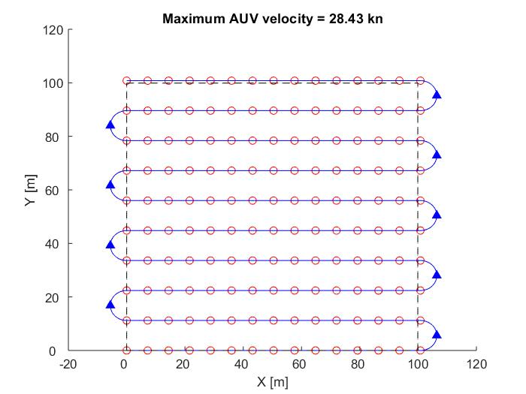
Path
X samples set to 15
Y samples set to 10

Slide 6
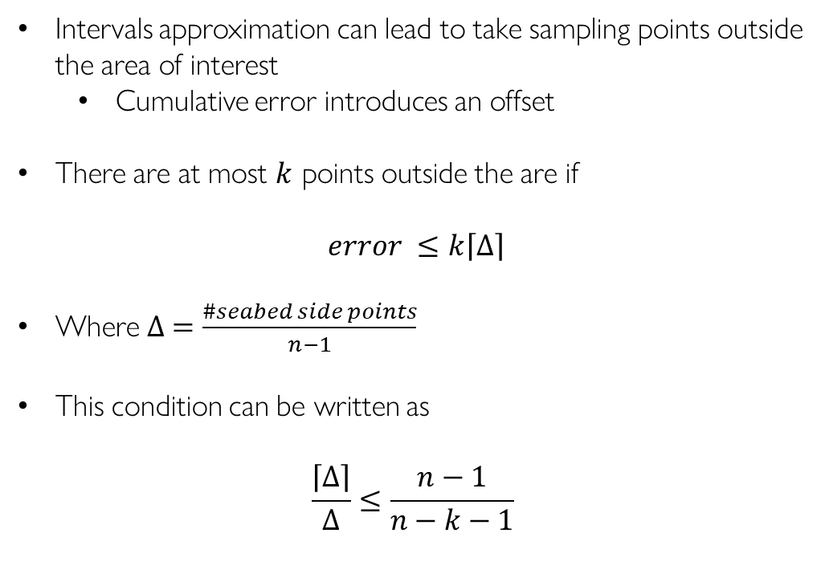
Path
Intervals approximation can lead to take sampling points outside the area of interest
Cumulative error introduces an offset
There are at most $k$ points outside the are if
$$error ≤k\left\lceil ∆\right\rceil$$
Where $∆ =\frac{\#seabed side points}{n−1}$
This condition can be written as
$$\frac{\left\lceil ∆\right\rceil }{∆}≤\frac{n−1}{n−k−1}$$

Slide 7


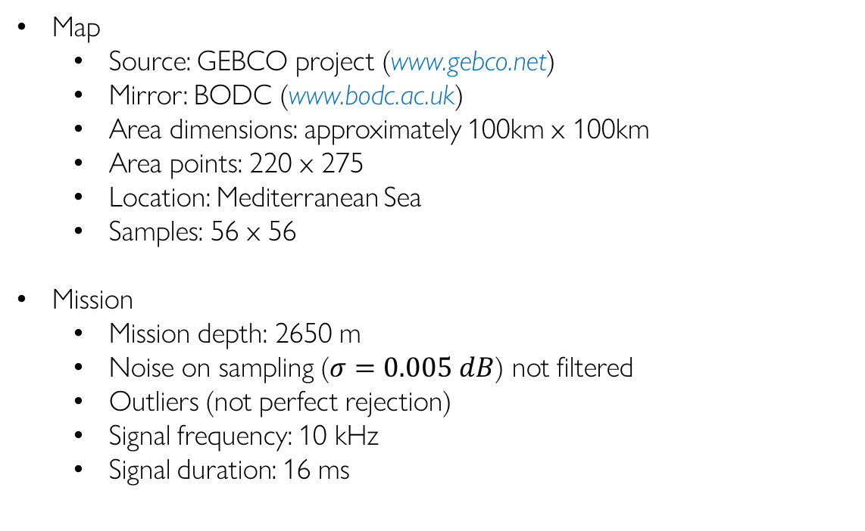
Using real data
Map
Source: GEBCO project (www.gebco.net)
Mirror: BODC (www.bodc.ac.uk)
Area dimensions: approximately 100km x 100km
Area points: 220 x 275
Location: Mediterranean Sea
Samples: 56 x 56
Mission
Mission depth: 2650 m
Noise on sampling ($σ=0.005 dB$) not filtered
Outliers (not perfect rejection)
Signal frequency: 10 kHz
Signal duration: 16 ms

Slide 8
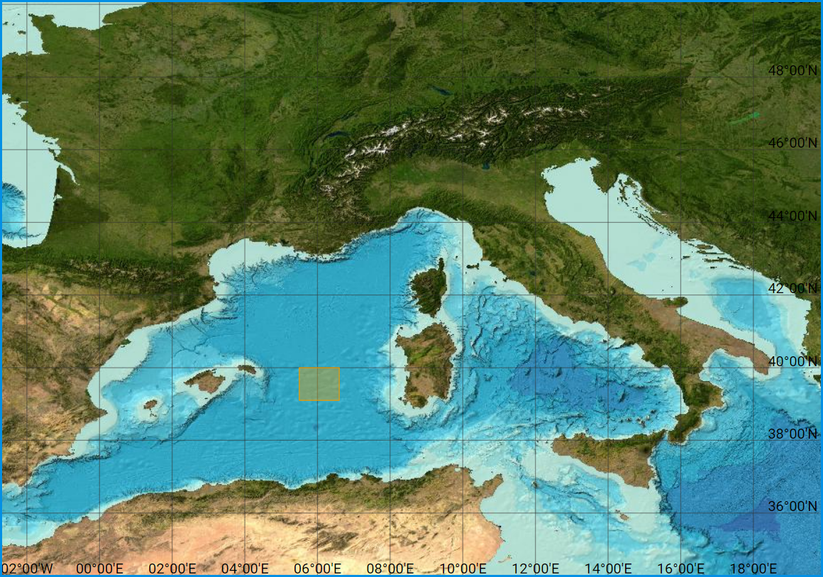
Using real data

Slide 9
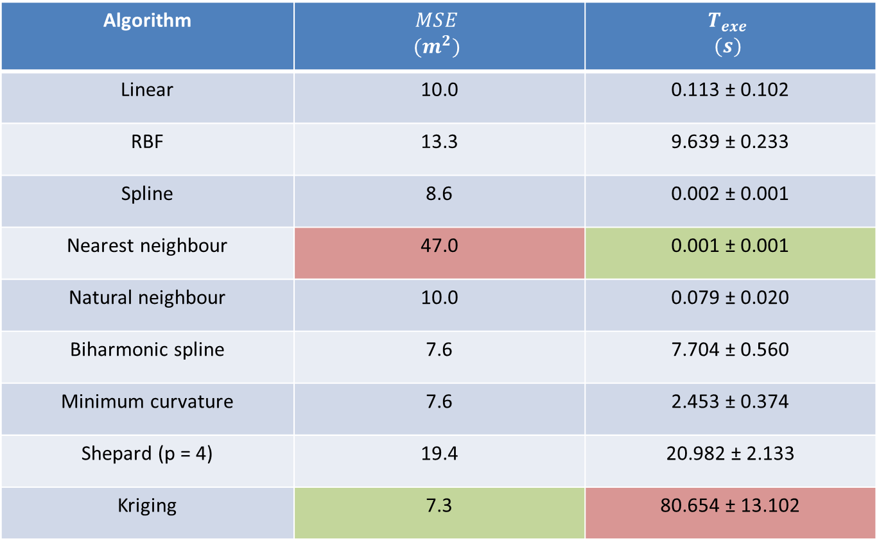
Real seabed: results
Algorithm | $$MSE$$ $$(m^{2})$$ | $$T_{exe}$$ $$(s)$$
Linear | 10.0 | 0.113 ± 0.102
RBF | 13.3 | 9.639 ± 0.233
Spline | 8.6 | 0.002 ± 0.001
Nearest neighbour | 47.0 | 0.001 ± 0.001
Natural neighbour | 10.0 | 0.079 ± 0.020
Biharmonic spline | 7.6 | 7.704 ± 0.560
Minimum curvature | 7.6 | 2.453 ± 0.374
Shepard (p = 4) | 19.4 | 20.982 ± 2.133
Kriging | 7.3 | 80.654 ± 13.102

Slide 10

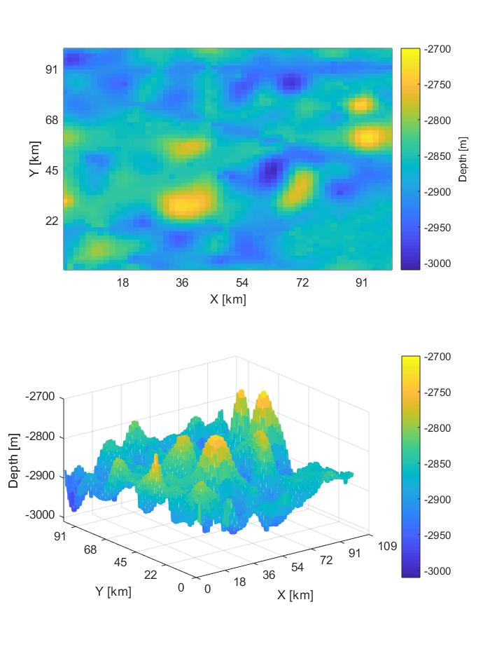
Real seabed: results
Original
Kriging
Nearest neighbour

Slide 11

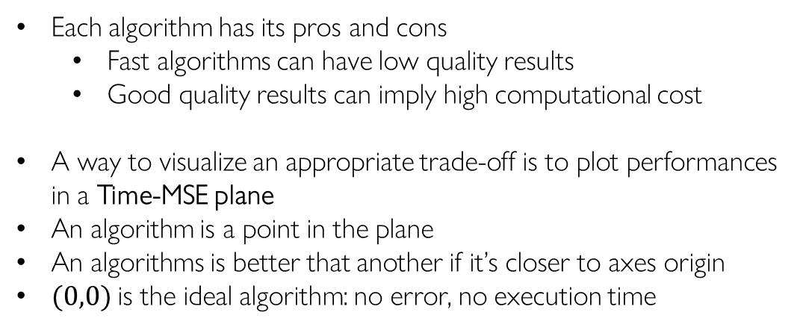
Performances trade-off
Each algorithm has its pros and cons
Fast algorithms can have low quality results
Good quality results can imply high computational cost
A way to visualize an appropriate trade-off is to plot performances in a Time-MSE plane
An algorithm is a point in the plane
An algorithms is better that another if it’s closer to axes origin
$(0,0)$is the ideal algorithm: no error, no execution time
Better
$J= {MSE}^{2}+T_{EXE}^{2}$
MSE
Best
Time
Notes:
NOTA: dire che il migliore è il più vicino all’origine vuol dire minimizzare J = MSE^2 + TIME^2 ->Hanno lo stesso peso

Slide 12
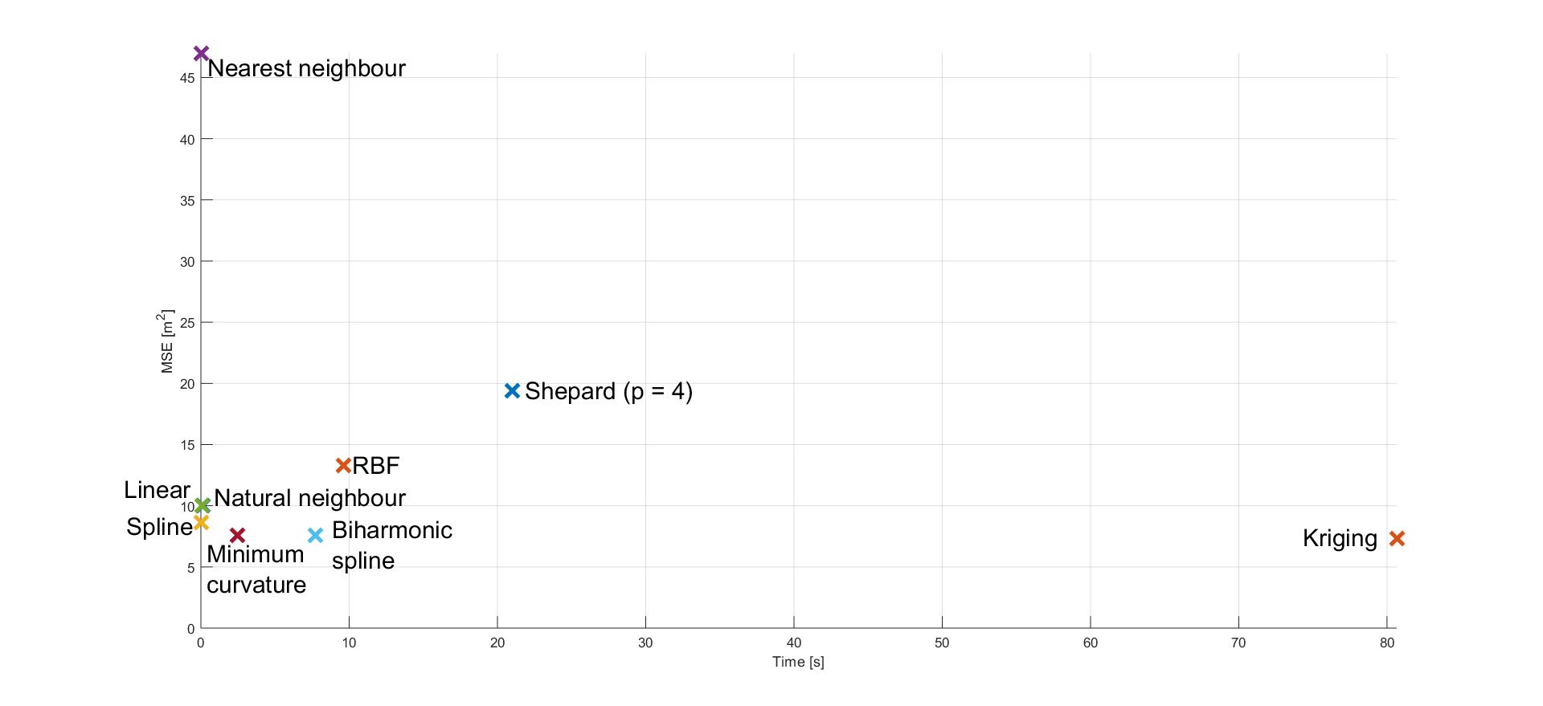
Real seabed

Slide 13
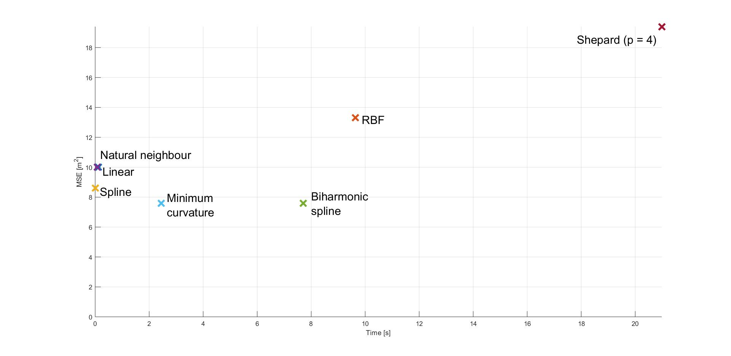
Real seabed
Nearest Neighbour
Kriging

Slide 14

Real seabed: results
Original
Kriging
Minimum curvature

Slide 15
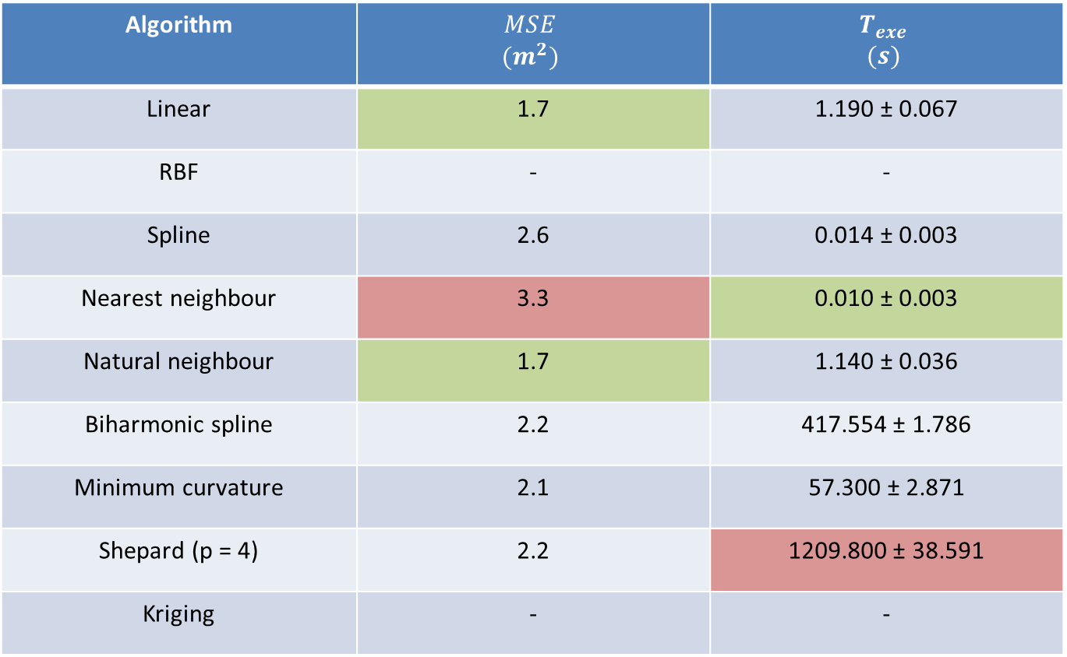
Gaussian seabed 100m x 100m: results
Algorithm | $$MSE$$ $$(m^{2})$$ | $$T_{exe}$$ $$(s)$$
Linear | 1.7 | 1.190 ± 0.067
RBF | - | -
Spline | 2.6 | 0.014 ± 0.003
Nearest neighbour | 3.3 | 0.010 ± 0.003
Natural neighbour | 1.7 | 1.140 ± 0.036
Biharmonic spline | 2.2 | 417.554 ± 1.786
Minimum curvature | 2.1 | 57.300 ± 2.871
Shepard (p = 4) | 2.2 | 1209.800 ± 38.591
Kriging | - | -
Notes:
RBF: out of memory error
Kriging: out of memory error possibile e tempo di esecuzione dell’ordine delle ore

Slide 16
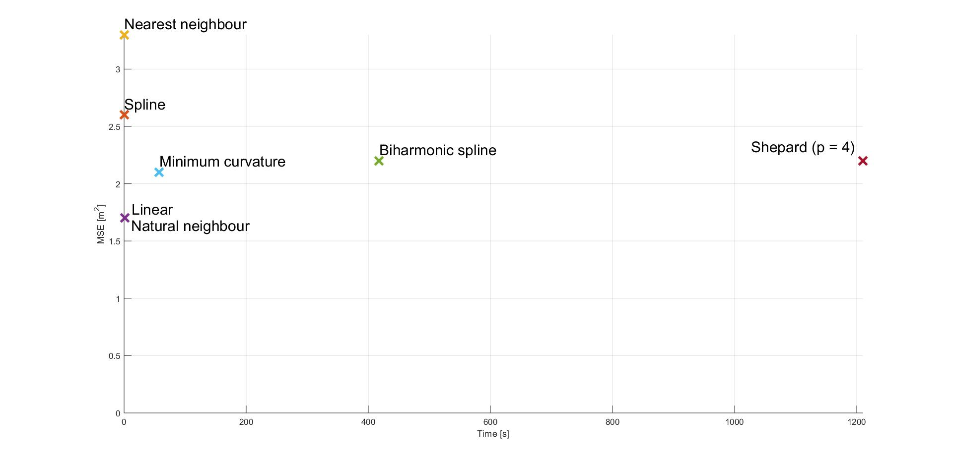
Gaussian seabed 100m x 100m: results

Slide 17
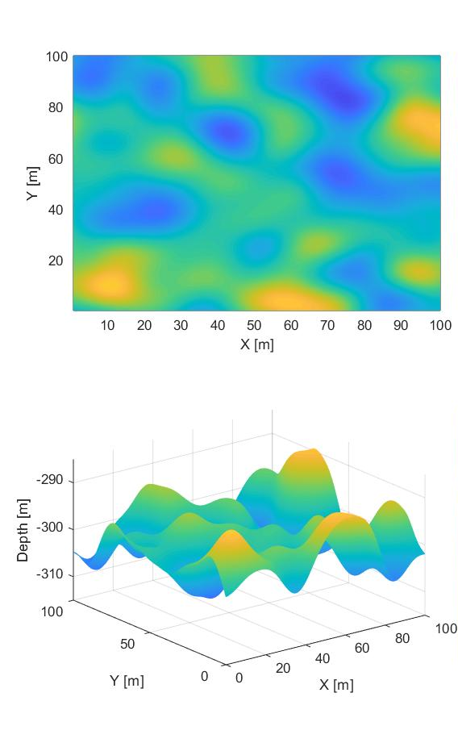
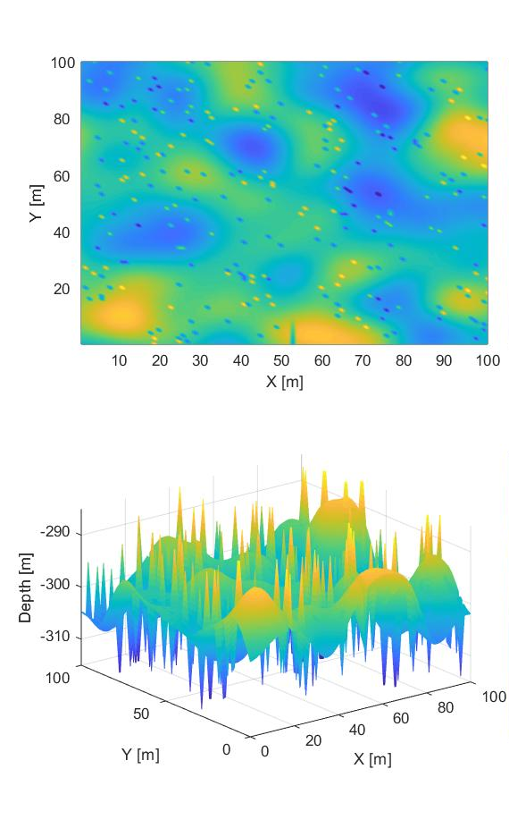
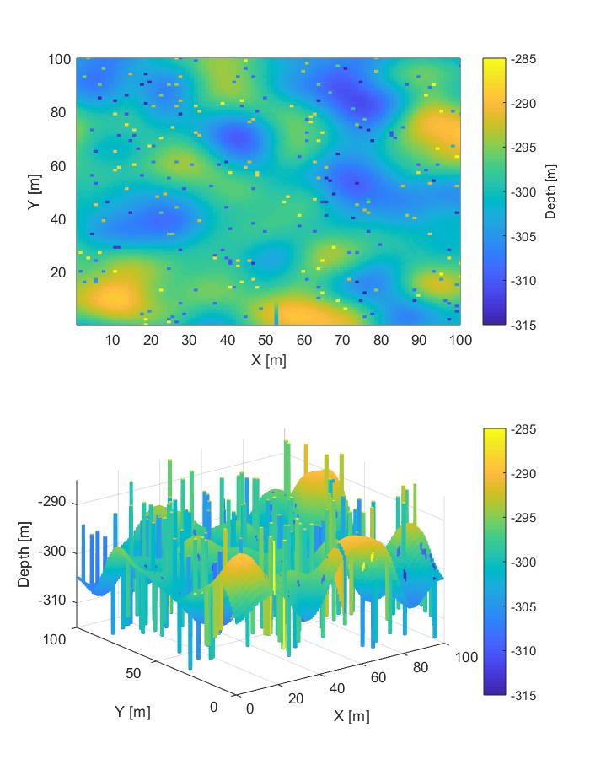
Gaussian seabed 100m x 100m: results
Original
Linear
Minimum curvature

